Slide 1
Design and Stability of Load-side Frequency Control
Changhong Zhao*
Enrique Mallada*
Steven Low
EE, CMS, Caltech
Ufuk Topcu
U Penn
Lina Li
Harvard
July 2015
Notes:
May 2012: Santa Fe Institute Workshop on Smart Grid, Santa Fe, NM
July 2012: Network Science Workshop, Chinese University of Hong Kong, HK (Raymond Yeung)
Sept 2012: Melbourne University, EEE Department (Pascal van Hentenryck)
February 13, 2013: ITA Workshop, San Diego
May 20, 2013: IEEE Workshop on Modeling and Simulation of Cyber-Physical Energy Systems, Berkeley, CA (Peter Palensky, Edward A. Lee)
Oct 31, 2013: Google, Mountain View, CA (Arun Mazumdar)
Nov 5, 2013: Asilomar Conference, invited session on Power Networks (Edmund Yeh)
Nov 15, 2013: NSF Workshop on Smart Grid, Washington DC (Giannakis, Sairaj, SL)
Dec 2, 2013: UCLA EE (Mani Srivastava)
Dec 5, 2013: Keynote, GlobalSIP (Global Conf on Signal & Info Processing) Symposium on Signal Processing in Smart Grid (Shalinee Kishore, Lalitha Sankar)
Jan 16, 2014: Stanford Smart Grid seminar (Ram Rajagopal, Baosen Zhang)
Feb 4, 2014: 9th Annual CARNEGIE MELLON CONFERENCE ON THE ELECTRICITY INDUSTRY, (Marija Ilic, Krishnan Kant)
May 22, 2014: UC Berkeley (Kameshwar)
Oct 3, 2014: ASU (Junshan Zhang)
Nov 3, 2014: Asilomar Conference, invited session on Smart Grid: learning and optimization, Pacific Grove, CA
Nov 10, 2014: EE Control Group, Berkeley (Claire Tomlin)
Jan 16, 2015, Grid Science Winter School and Conference (Scott Backhaus, Misha Chertkov)
June 9, 2015: Advanced Mathematical Methods For Energy Systems: from Theory to Practice, Moscow, Russia (Janusz Bialek, Skoltech)
July 7, 2015, Tsinghua power systems group (Prof Song Yonghua)
July 21, 2015: Hong Kong University, EEE (David Hill, Victor Li)

Slide 2
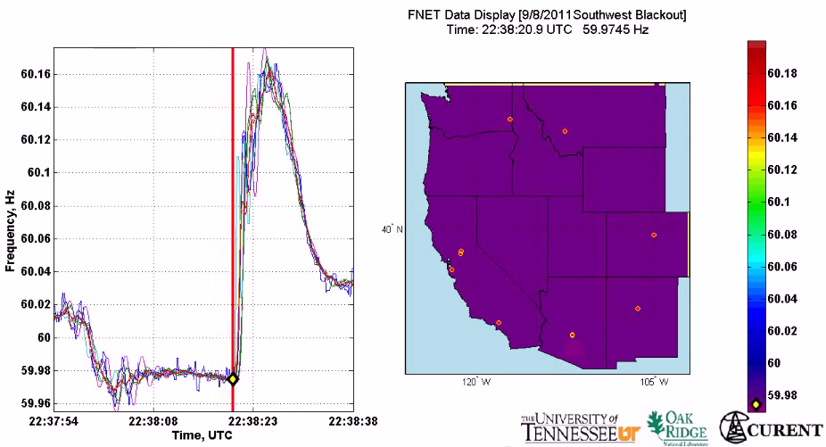
Motivation
All buses synchronized to same nominal frequency (US: 60 Hz; Europe/China: 50 Hz)
Supply-demand imbalance ➔ frequency fluctuation
(1 min)
2011 Southwest blackout

Slide 3
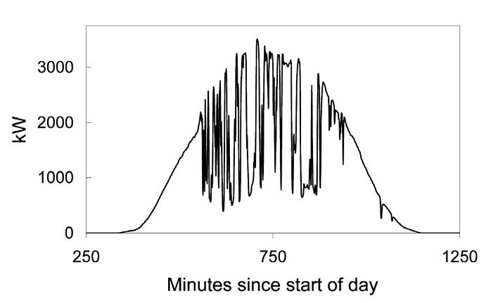
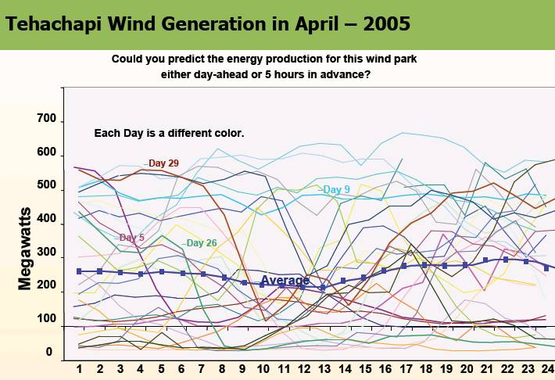
Motivation
Imagine when we have 50%+ renewable generation …
(10 min)
(1 min)

Slide 4
Why load-side participation
Ubiquitous continuous load-side control can supplement generator-side control
faster (no/low inertia)
no extra waste or emission
more reliable (large #)
better localize disturbances
reducing generator-side control capacity
secondary freq control
economic
dispatch
primary
freq control
sec
min
5 min
60 min

Slide 5
What is the potential
Residential load accounts
for ~1/3 of peak demand
61% residential appliances
are Grid Friendly
US:
operating reserve: 13% of peak
total GFA capacity: 18%
Lu & Hammerstrom (2006), PNNL

Slide 6
How
How to design load-side frequency control ?
How does it interact with generator-side control ?

Slide 7
Literature: load-side control
Original idea & early analytical work
Schweppe et al 1980; Bergin, Hill, Qu, Dorsey, Wang, Varaiya …
Small scale trials around the world
D.Hammerstrom et al 2007, UK Market Transform Programme 2008
Early simulation studies
Trudnowski et al 2006, Lu and Hammerstrom 2006, Short et al 2007, Donnelly et al 2010, Brooks et al 2010, Callaway and I. A. Hiskens, 2011, Molina-Garcia et al 2011
Analytical work – load-side control
Zhao et al (2012/2014), Mallada and Low (2014), Mallada et al (2014), Zhao and Low (2014), Zhao et al (2015)
Simpson-Porco et al 2013, You and Chen 2014, Zhang and Papachristodoulou (2014), Ma et al (2014), Zhao, et al (2014),
Recent analysis – generator-side/microgrid control:
Andreasson et al (2013), Zhang and Papachristodoulou (2013), Li et al (2014), Burger et al (2014), You and Chen (2014), Simpson-Porco et al (2013), Hill et al (2014), Dorfler et al (2014)

Slide 8
Outline
Network model
Load-side frequency control
Simulations
Details
Main references:
Zhao, Topcu, Li, Low, TAC 2014
Mallada, Zhao, Low, Allerton 2014
Zhao, Low, CDC 2014, Zhao et al CISS 2015

Slide 9
Network model
branch power
generation
Will include generator-side
control later
loads:
controllable + freq-sensitive
i : region/control area/balancing authority

Slide 10
Network model
Generator bus: M_{i} > 0
Load bus: M_{i} = 0
Damping/uncontr loads:
Controllable loads:

Slide 11
Network model
swing dynamics
all variables are deviations
from nominal
extends to nonlinear power flow

Slide 12
Frequency control
Suppose the system is in steady state
Then: disturbance in gen/load …

Slide 13
Frequency control
current
approach
load-side
control

Slide 14
Frequency control
Given: disturbance in gens/loads
Current: adapt remaining generators
re-balance power
restore nominal freq and inter-area flows (zero ACE)
Our goal: adapt controllable loads
re-balance power
restore nominal freq and inter-area flows
… while minimizing disutility of load control

Slide 15
Outline
Network model
Load-side frequency control
Simulations
Details
Main references:
Zhao, Topcu, Li, Low, TAC 2014
Mallada, Zhao, Low, Allerton 2014
Zhao, Low, CDC 2014, Zhao et al CISS 2015

Slide 16
Load-side controller design
Control goals (while min disutility)
Rebalance power & stabilize frequency
Restore nominal frequency
Restore scheduled inter-area flows
Respect line limits
Zhao, Topcu, Li, Low
TAC 2014
Mallada, Zhao, Low
Allerton, 2014

Slide 17
Load-side controller design
Control goals (while min disutility)
Rebalance power & stabilize frequency
Restore nominal frequency
Restore scheduled inter-area flows
Respect line limits
Zhao, Topcu, Li, Low
TAC 2014
Mallada, Zhao, Low
Allerton, 2014

Slide 18
Load-side controller design
Design control law
whose equilibrium
solves:
load disutility
power balance
inter-area flows
line limits
Control goals (while min disutility)
Rebalance power & stabilize frequency
Restore nominal frequency
Restore scheduled inter-area flows
Respect line limits
freq will emerge as
Lagrange multiplier
for power imbalance

Slide 19
Load-side controller design
Design control (G, F) s.t. closed-loop system
is stable
has equilibrium that is optimal
power network
load control

Slide 20
Load-side controller design
Idea: exploit system dynamic as part of primal-dual algorithm for modified opt
Distributed algorithm
Stability analysis
Control goals in equilibrium
power network
load control

Slide 21
Summary: control architecture
physical network
Primary load-side frequency control
completely decentralized
Theorem: stable dynamic, optimal equilibrium
Zhao, Topcu, Li, Low. TAC 2014

Slide 22
Summary: control architecture
physical network
cyber network
Secondary load-side frequency control
communication with neighbors
Theorem: stable dynamic, optimal equilibrium
Mallada, Zhao, Low. Allerton 2014

Slide 23
Summary: control architecture
physical network
cyber network
With generator-side control, nonlinear power flow
load-side improves both transient & eq
Theorem: stable dynamic, optimal equilibrium
Zhao, Mallada, Low. CISS 2015

Slide 24
example:
secondary control

Slide 25
Recall: design approach
Idea: exploit system dynamic as part of primal-dual algorithm for modified opt
closed-loop system is stable
its equilibria are optimal
power network
load control

Slide 26
OLC for secondary control
demand = supply
restore nominal freq

Slide 27
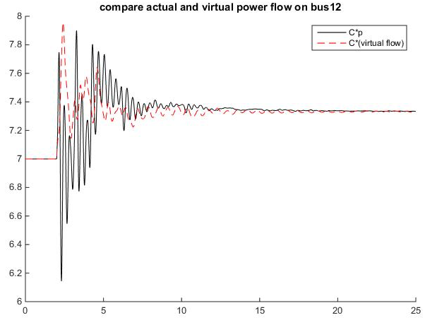
OLC for secondary control
demand = supply
restore nominal freq
key idea: “virtual flows”
in steady state:
virtual flow = real flows

Slide 28
OLC for secondary control
demand = supply
restore nominal freq
restore inter-area flow
respect line limit
in steady state:
virtual flow = real flows

Slide 29
Control architecture

Slide 30
Secondary frequency control
load control:
computation & communication:
primal var:
dual vars:

Slide 31
Secondary control works
Theorem
starting from any initial point, system
trajectory converges s. t.
is unique optimal of OLC
nominal frequency is restored
inter-area flows are restored
line limits are respected

Slide 32
Recap: key ideas
Design optimal load control (OLC) problem
Objective function, constraints
Derive control law as primal-dual algorithms
Lyapunov stability
Achieve original control goals in equilibrium
Distributed algorithms
primary control:
secondary control:

Slide 33
Recap: key ideas
Design optimal load control (OLC) problem
Objective function, constraints
Derive control law as primal-dual algorithms
Lyapunov stability
Achieve original control goals in equilibrium
Distributed algorithms
Virtual flows
Enforce desired properties on line flows
in steady state: virtual flow = real flows

Slide 34
Outline
Network model
Load-side frequency control
Simulations
Details
Main references:
Zhao, Topcu, Li, Low, TAC 2014
Mallada, Zhao, Low, Allerton 2014
Zhao, Low, CDC 2014, Zhao et al CISS 2015

Slide 35
Simulations
Dynamic simulation of IEEE 39-bus system
Power System Toolbox (RPI)
Detailed generation model
Exciter model, power system
stabilizer model
Nonzero resistance lines

Slide 36
Primary control

Slide 37
Secondary control
swing dynamics
with OLC
area 1

Slide 38
Secondary control
line limit
no line limits
Total inter-area flow is
the same in both cases
line limit
with line limits

Slide 39
Conclusion
Forward-engineering design facilitates
explicit control goals
distributed algorithms
stability analysis
Load-side frequency regulation
primary & secondary control works
helps generator-side control

Slide 40
Outline
Network model
Load-side frequency control
Simulations
Details
Main references:
Zhao, Topcu, Li, Low, TAC 2014
Mallada, Zhao, Low, Allerton 2014
Zhao, Low, CDC 2014, Zhao et al CISS 2015

Slide 41
more details
(backup)

Slide 42
Recall: design approach
Idea: exploit system dynamic as part of primal-dual algorithm for modified opt
closed-loop system is stable
its equilibria are optimal
power network
load control

Slide 43
Outline
Load-side frequency control
Primary control
Secondary control
Interaction with generator-side control
Zhao et al SGC2012, Zhao et al TAC2014

Slide 44
Optimal load control (OLC)
demand = supply
disturbances
controllable
loads

Slide 45
system dynamics + load control = primal dual alg
swing dynamics
implicit
load control
active control

Slide 46
Control architecture

Slide 47
Load-side primary control works
Theorem
Starting from any
system trajectory
converges to
is unique optimal of OLC
is unique optimal for dual
completely decentralized
frequency deviations contain right info for local decisions that are globally optimal

Slide 48
Recap: control goals
Rebalance power
Stabilize frequencies
Restore nominal frequency
Restore scheduled inter-area flows
Respect line limits
Yes
Yes
No
No
No

Slide 49
Outline
Load-side frequency control
Primary control
Secondary control
Interaction with generator-side control
Mallada, Low, IFAC 2014
Mallada et al, Allerton 2014

Slide 50
OLC for secondary control
demand = supply
restore nominal freq

Slide 51
OLC for secondary control
demand = supply
restore nominal freq
key idea: “virtual flows”
in steady state:
virtual flow = real flows

Slide 52
OLC for secondary control
demand = supply
restore nominal freq
restore inter-area flow
respect line limit
in steady state:
virtual flow = real flows

Slide 53
Recall: primary control
swing dynamics:
implicit
active
control
load control:

Slide 54
Control architecture
physical network
cyber network

Slide 55
Secondary frequency control
load control:
computation & communication:
primal var:
dual vars:

Slide 56
Secondary control works
Theorem
starting from any initial point, system
trajectory converges s. t.
is unique optimal of OLC
nominal frequency is restored
inter-area flows are restored
line limits are respected

Slide 57
Recap: key ideas
Design optimal load control (OLC) problem
Objective function, constraints
Derive control law as primal-dual algorithms
Lyapunov stability
Achieve original control goals in equilibrium
Distributed algorithms
primary control:
secondary control:

Slide 58
Recap: key ideas
Design optimal load control (OLC) problem
Objective function, constraints
Derive control law as primal-dual algorithms
Lyapunov stability
Achieve original control goals in equilibrium
Distributed algorithms
Virtual flows
Enforce desired properties on line flows
in steady state: virtual flow = real flows

Slide 59
Recap: control goals
Rebalance power
Resynchronize/stabilize frequency
Restore nominal frequency
Restore scheduled inter-area flows
Respect line limits
Yes
Yes
Zhao, et al TAC2014
Yes
Yes
Yes
Mallada, et al Allerton2014
Secondary control restores nominal
frequency but requires local communication

Slide 60
Outline
Load-side frequency control
Primary control
Secondary control
Interaction with generator-side control
Zhao and Low, CDC2014
Zhao, Mallada, Low, CISS 2015

Slide 61
Generator-side control
New model: nonlinear PF, with generator control
Recall model: linearized PF, no generator control

Slide 62
Generator-side control
New model: nonlinear PF, with generator control
generator bus: real power injection
load bus: controllable load

Slide 63
Generator-side control
New model: nonlinear PF, with generator control
generator buses:

Slide 64
Load-side control
physical network
cyber network

Slide 65
Load-side primary control works
Theorem
Every closed-loop equilibrium solves OLC and its dual
Suppose
Any closed-loop equilibrium is (locally) asymptotically stable provided

